Slide 1

GROOVY zero fucks given
by Willem Scheppers and Mattia Romeo

Slide 2

Java Groovy
Why Groovy?
Scala Kotlin
Notes:
Why Groovy? Why not any of the other popular JVM Languages? What makes Groovy so special?

Slide 3
Why Groovy?
95% of Java code is also valid Groovy code
Concepts in Groovy are present in other JVM languages
Groovy enables fast development
Sometimes it’s easier to use Groovy
Sometimes Groovy is all you got
Notes:
- 95% of Java code is also valid Groovy code
Easier for Java developers to learn Groovy
- Concepts in Groovy are present in other JVM languages
After working with Groovy, concepts in other JVM languages will become familiar / By learning Groovy, you’re learning concepts used in other JVM languages
string interpolation, “it” keyword, type inference, extensions (adding methods to existing classes)
- Groovy enables fast development
Groovy has less boilerplate: map/list literals, all exceptions are runtime exceptions, getters/setters are generated
Combined with Gradle, it’s easy to set up a task driven project
- Sometimes it’s easier to use Groovy
Groovy supports parsing and producing Json/XML (included in the standard libraries)
Because Groovy is dynamic, there is no need for boilerplate code
- Sometimes Groovy is all you got
If you use Jenkins, you’re forced to use Groovy

Slide 4

Disclaimer
This presentation will not teach you how you should use Groovy
This presentation will teach you how we use Groovy
Notes:
Don’t dead open inside

Slide 5
How do we use Groovy?
Groovy Console
Gradle
Build Script
Plugin
Jenkins
Pipeline
Shared Library

Slide 6

Groovy Console
Getting Started
IntelliJ
Find Action (Ctrl-Shift-A)
Menubar > Tools
Useful for
Testing fragments/snippets of code
Transforming data with complex transformations
Practical uses
Notes:
Do some live coding!
You can run Groovy code directly in IntelliJ’s Groovy console.
This is a great tool to test fragments or snippets of code
Transform data with complex transformations
E.g. transform a list of dash separated strings into lower camelcase
Has practical uses, for example:
encode/decode something in base64: "username:password".bytes.encodeBase64() or "c29tZXNlY3JldGJhc2U2NHN0cmluZw==".decodeBase64()
Parse some json/xml

Slide 7
Groovy Console
Live Coding
Notes:
Do some live coding!
You can run Groovy code directly in IntelliJ’s Groovy console.
This is a great tool to test fragments or snippets of code
Transform data with complex transformations
E.g. transform a list of dash separated strings into lower camelcase
Has practical uses, for example:
encode/decode something in base64: "username:password".bytes.encodeBase64() or "c29tZXNlY3JldGJhc2U2NHN0cmluZw==".decodeBase64()
Parse some json/xml

Slide 8
Groovy Console recap
Implicit getters and setters
Optional semicolons and parentheses
def keyword
Map and List literals
Groovy Closure
String interpolation
‘it’ keyword
Notes:
Not mentioned:
Return statement is optional
Operator overloading
Don’t use Gstring for keys in maps

Slide 9
Groovy Console recap
Implicit getters and setters
Optional semicolons and parentheses
def keyword
Map and List literals
Groovy Closure
String interpolation
‘it’ keyword
Notes:
Not mentioned:
Return statement is optional
Operator overloading
Don’t use Gstring for keys in maps

Slide 10
Groovy Closure
Groovy | Java
{ doSomething() } { -> doSomething() } | () -> { doSomething(); }; () -> doSomething();
{ doSomething(it) } | (a) -> doSomething(a);
{ a, b -> doSomething(a,b) } | (a,b) -> doSomething(a, b);
this.&doSomething | this::doSomething

Slide 11

Gradle
Getting started
Create a new text file named ‘build.gradle’ in a new folder
Open the file with IntelliJ
Notes:
Do some live coding!
Hello word
Write some java code
You can use IntelliJ’s “New Project”, but it might add boilerplate you won’t need
Open build.gradle in IntelliJ
IntelliJ runs wrapper task (gradle-wrapper jar & properties + gradlew)
System.out.println
Code always runs -> Configuration phase vs Execution phase
doFirst or doLast
Groovy vs Java
Closures vs Lambdas
Semicolons and parentheses are optional
Last argument is a closure -> parentheses around previous arguments
‘it’ keyword
Delegate
String interpolation

Slide 12
Build Script recap
Gradle’s Configuration phase vs Execution phase
Delegate
Groovy DSL

Slide 13
Build Script recap
Gradle’s Configuration phase vs Execution phase
Delegate
Groovy DSL
Notes:
Gradle has 3 phases:
Initialization
Settings, create Project for every project
Configuration
Evaluate build script
Task graph for request tasks
Execution
Schedules and executes each of the selected tasks in order of dependencies

Slide 14
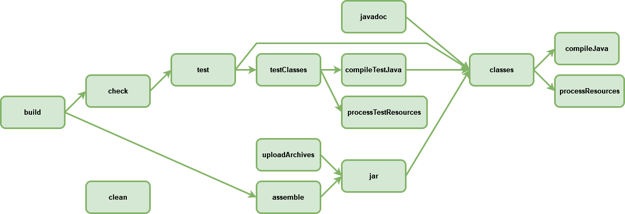
Task graph – Configuration phase
Notes:
Standard tasks for the java plugin

Slide 15
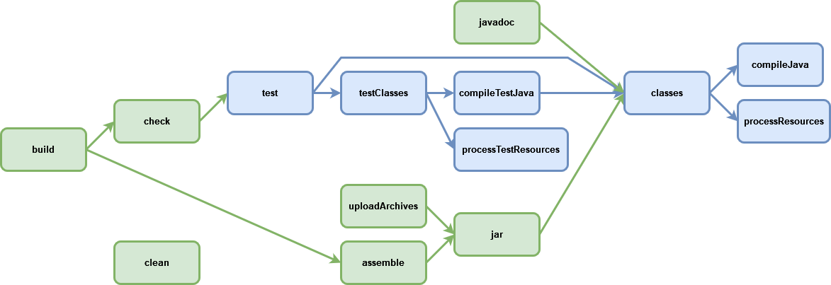
Task graph – Execution phase
Notes:
What happens when we run the test task:
- test classes will:
- compile test classes
- process test resources
- main classes will also run and
- compile main classes
- process main resources

Slide 16
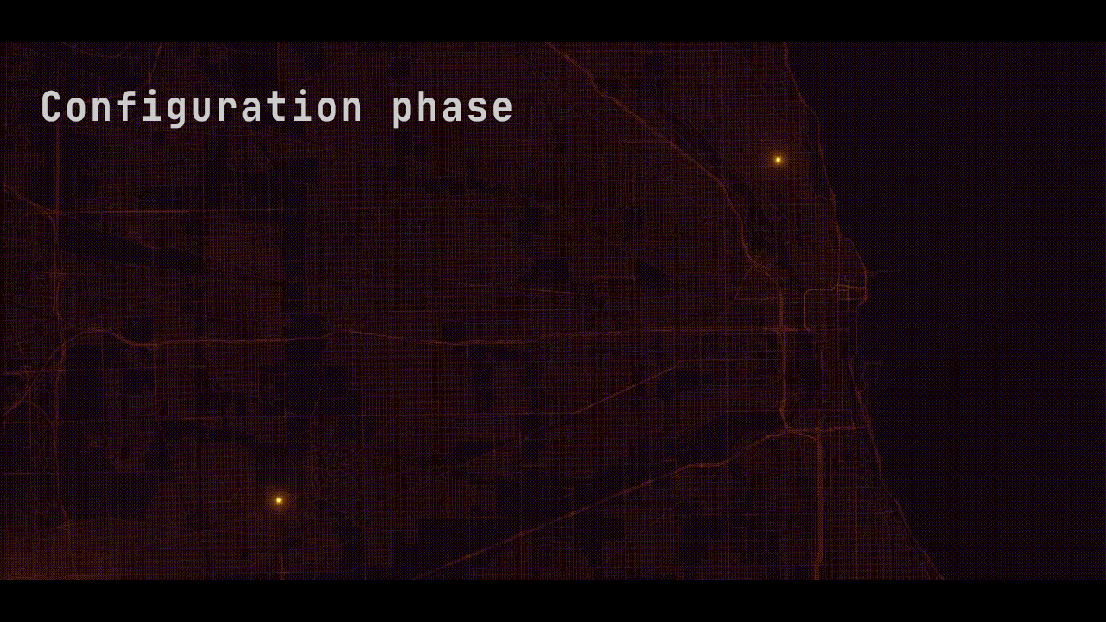
Notes:
- Think of the configuration phase as Gradle discovering all the tasks that are present in the project and subprojects and how they depend on each other
- In the execution phase Gradle will execute the task and all dependent tasks
-> Configuration phase tells IntelliJ what tasks are present in a Gradle project, this is why you must “Load Gradle changes” before they’re visible in IntelliJ

Slide 17
Build Script recap
Gradle’s Configuration phase vs Execution phase
Delegate
Groovy DSL
Notes:
A Groovy build script is an example of a DSL (domain specific language)
Using the groovy language, we can write code that is concise and readable. That can be used without full knowledge of the Groovy language.

Slide 18
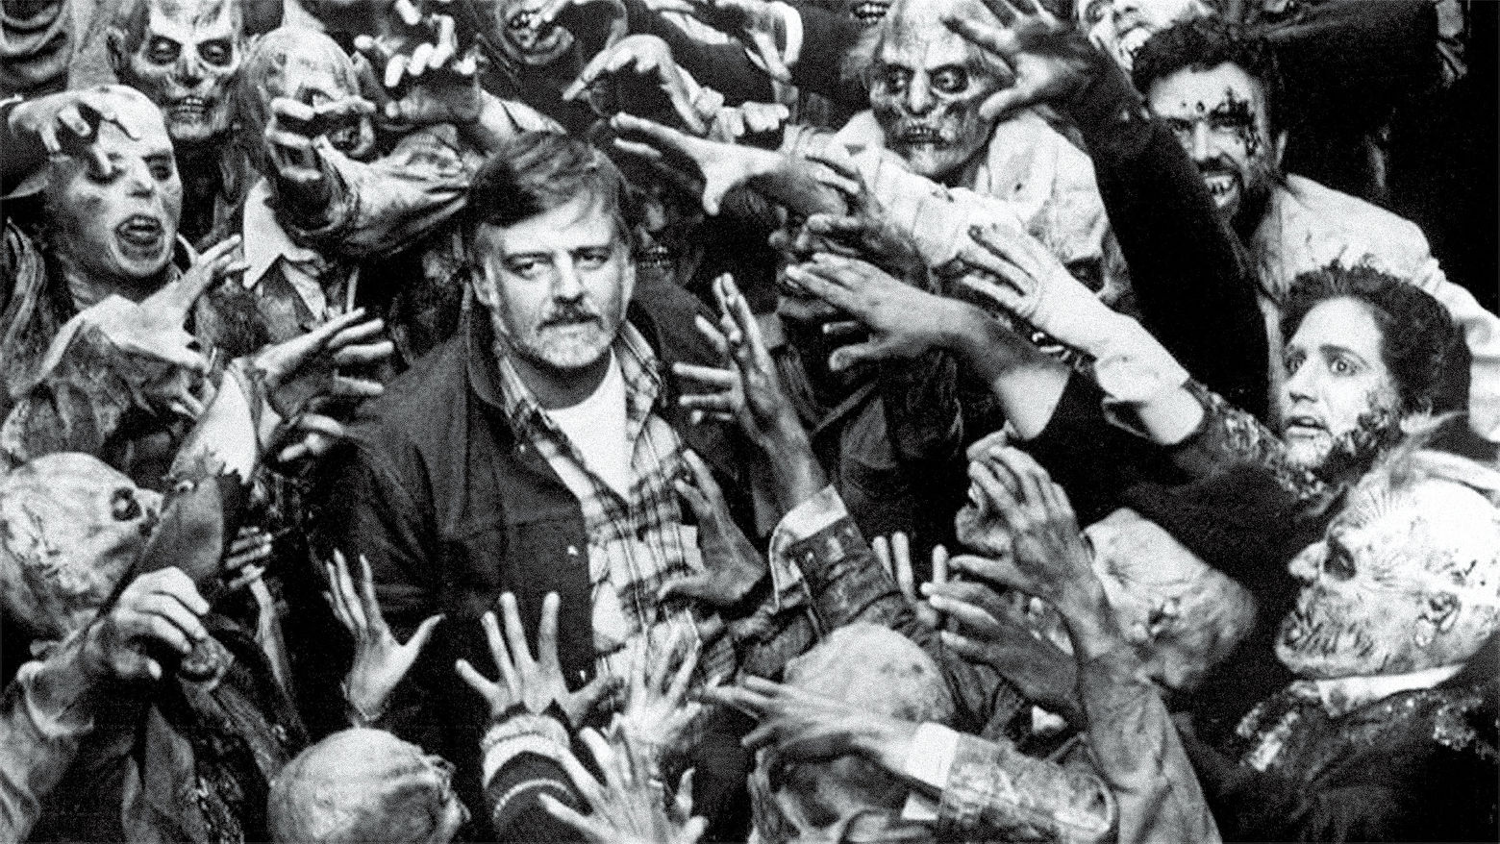
Groovy is all you got

Slide 19

Jenkins Pipeline DSL
pipeline {
agent {
label ‘commit’
}
stages {
stage(‘checkout’) {
steps {
gitCheckout ‘groovy-for-java-devs’
}
}
stage(‘build’) {
steps {
gradlew(tasks: ‘build’, directory: ‘groovy-for-java-devs’)
}
}
}
post {
always {
junit ‘**/build/reports/**/*.xml’
}
}
}
Declarative pipeline is a Groovy DSL
Notes:
If you want to take advantage of Jenkins’ IAC (infrastructure as code), you have to use Groovy
Much more constraints
Can’t call methods or attributes on objects
Use script block
Use shared libraries

Slide 20
Jenkins Pipeline DSL
pipeline {
agent {
label ‘commit’
}
stages {
stage(‘checkout’) {
steps {
gitCheckout ‘groovy-for-java-devs’
}
}
stage(‘build’) {
steps {
gradlew(tasks: ‘build’, directory: ‘groovy-for-java-devs’)
}
}
}
post {
always {
junit ‘**/build/reports/**/*.xml’
}
}
}
Declarative pipeline is a Groovy DSL

Slide 21
Jenkins Shared Libraries
Reusable code blocks within Jenkins pipelines
Unit test with Jenkins-Spock
Examples:
gradlew
gitCheckout
Notes:
Common patterns used across pipelines can be captured in a shared library this allows you to keep your jenkinsfile concise and clutterfree

Slide 22
Shared Library
#!/usr/bin/env groovy
def call() {
…
}
Notes:
A Groovy build script is an example of a DSL (domain specific language)
Using the groovy language, we can write code that is concise and readable. That can be used without full knowledge of the Groovy language.

Slide 23
gradlew.groovy
def parameters = (tasks +
disabledTasks.collect { "-x $it" } +
systemProperties.collect { "-D${it.key}=${it.value}" } +
properties.collect { "-P${it.key}=${it.value}" } +
options.collect { "--$it" }
).join(' ')
dir(directory) {
output = sh(script: "./gradlew $parameters")
}
return output
Notes:
A Groovy build script is an example of a DSL (domain specific language)
Using the groovy language, we can write code that is concise and readable. That can be used without full knowledge of the Groovy language.

Slide 24
Jenkins Pipeline DSL
pipeline {
agent {
label ‘commit’
}
stages {
stage(‘checkout’) {
steps {
gitCheckout ‘groovy-for-java-devs’
}
}
stage(‘build’) {
steps {
gradlew(tasks: ‘build’, directory: ‘groovy-for-java-devs’)
}
}
}
post {
always {
junit ‘**/build/reports/**/*.xml’
}
}
}
Declarative pipeline is a Groovy DSL

Slide 25

What else you got?

Slide 26
Throughout the years, we’ve noticed these use cases were easier to implement in Groovy, as opposed to Java

Slide 27
Working with files
withWriter/withReader
All exceptions are runtime exceptions

Slide 28
Parsing and producing XML/JSON
JsonSlurper
XmlSlurper/Xmlparser

Slide 29
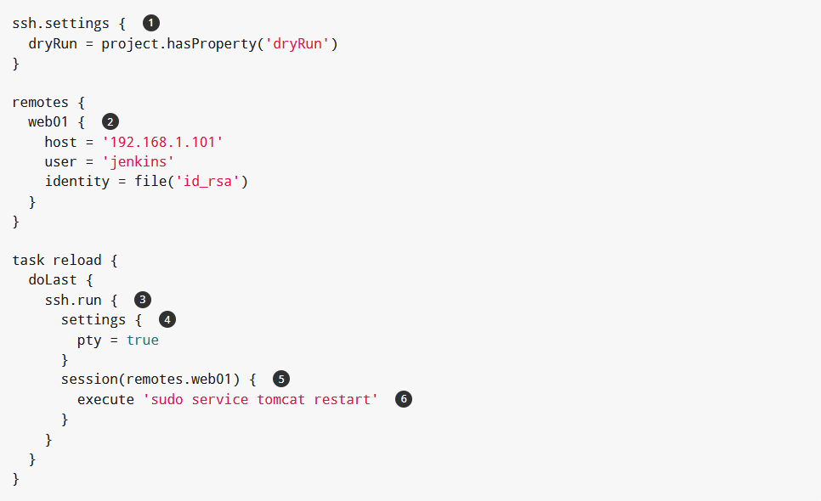
Gradle SSH plugin

Slide 30
Working with files in Gradle
Automic path separator
file, fileTree, zipTree
Copy and Zip tasks
configurations

Slide 31
SSH
https://gradle-ssh-plugin.github.io/docs/

Slide 32
Tip of the iceberg
Closure
Optional Typing
Gstrings vs String
Operators
Null safety (?.), Elvis (?:) , matching (=~), identical (===)
Optional return, braces, semicolon
Collections
Collect, find, join
Implicit Getter/Setter
Map argument constructor
Method references

Slide 33
Below …
Default public and package private
Delegate and owners
Operator overloading
Overwriting protected keywords
missingMethod and missingProperty
metaClass
Mixin
Grape
CliBuilder
SwingBuilder

Slide 34
Sources
Why Groovy
A Groovy journey in Open Source land by Guillaume Laforge
https://www.youtube.com/watch?v=ccm7KeHUFyc
https://groovy-lang.org/
Jenkins
https://www.jenkins.io/doc/book/pipeline/syntax/#differences-from-plain-groovy
https://www.jenkins.io/doc/book/pipeline/shared-libraries/

Slide 35
Sources
Images/Video
Title - Evil Dead II (1987)
Why Groovy – Left 4 dead 1 video game
Disclaimer - The Walking Dead – S01E01 (2010)
Groovy is all you got - Day of the Dead - BTS (1985)
Gradle phases - https://www.youtube.com/watch?v=CgW0HPHqFE8
What else you got? - Dawn of the Dead (2004)

Slide 36
Code examples
https://groovy-lang.org/
Operator overloading
http://docs.groovy-lang.org/docs/latest/html/documentation/core-domain-specific-languages.html#_operator_overloading
xml
https://groovy-lang.org/processing-xml.html
json
https://groovy-lang.org/processing-json.html

